Slide 1
Strategic management Chapter 10
Strategic Management. Fred R.David • Forest R.David. 15th ed., 2015 .Pearson Education

Slide 2
Strategy Execution

Slide 3

Strategy Execution
A technically imperfect plan that is implemented well will achieve more than the perfect plan that never gets off the paper on which it is typed.

Slide 4

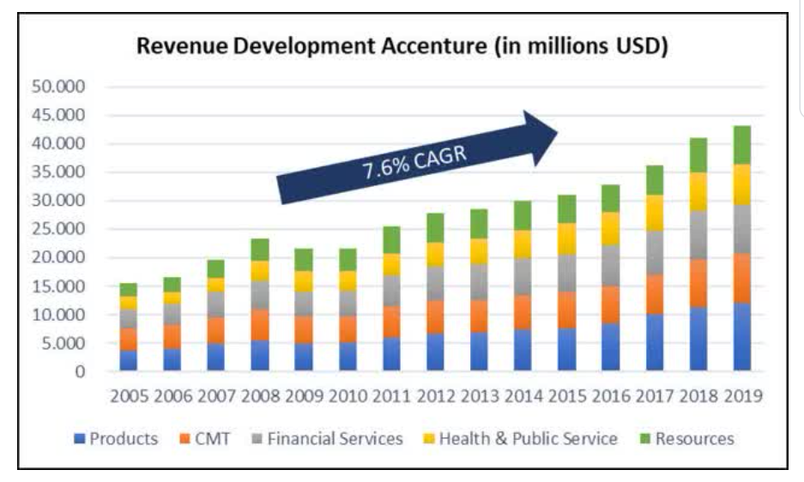

Accenture
• Communications, Media & Technology
• Financial Services
• Products
• Resources
• Health & Public Service.

Slide 5
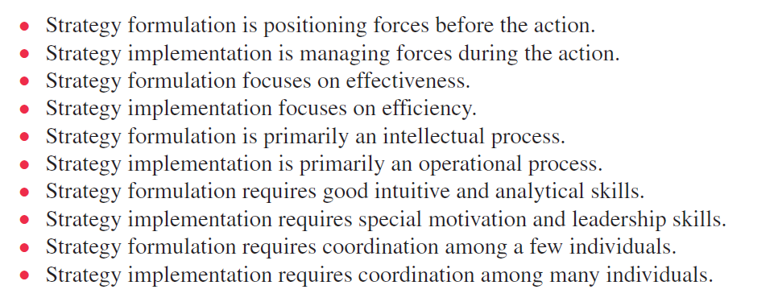
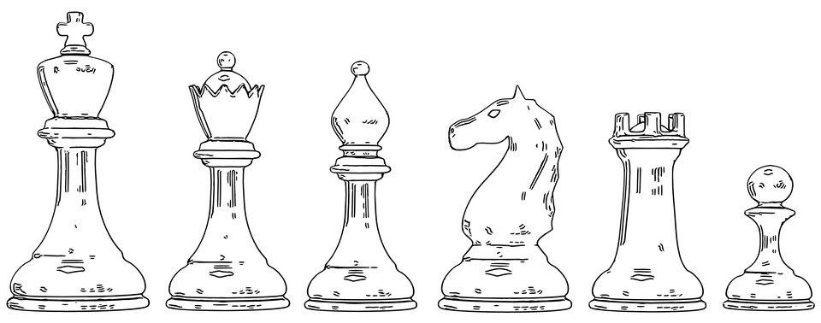
Formulation/Implementation
Strategy implementation varies substantially among different types and sizes of organizations.

Slide 6
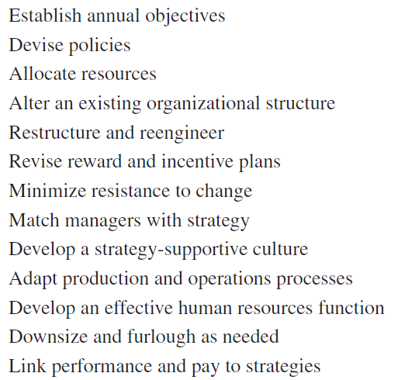

Implementation
Strategists to Functional managers
Shift in responsibility
Implementation problems can arise because of this shift in responsibility, especially if strategy-formulation decisions come as a surprise to middle- and lower-level managers

Slide 7


Implementation
Top-down flow of communication is essential for developing bottom-up support.
Every employee should be able to benchmark her or his efforts against best-in-class competitors so that the challenge becomes personal.
Starbucks says 30 percent of employees’ time is motion and the company wants to reduce that. They say “motion and work are two different things.”

Slide 8

Annual Objectives
Establishing annual objectives is a decentralized activity that directly involves all managers in an organization
Approving, revising, or rejecting annual objectives is much more than a rubber-stamp activity
Directing and channeling efforts and activities of organization members.
They provide a source of legitimacy in an enterprise by justifying activities to stakeholders.
They serve as standards of performance.
They serve as an important source of employee motivation and identification.
They give incentives for managers and employees to perform.
They provide a basis for organizational design.

Slide 9
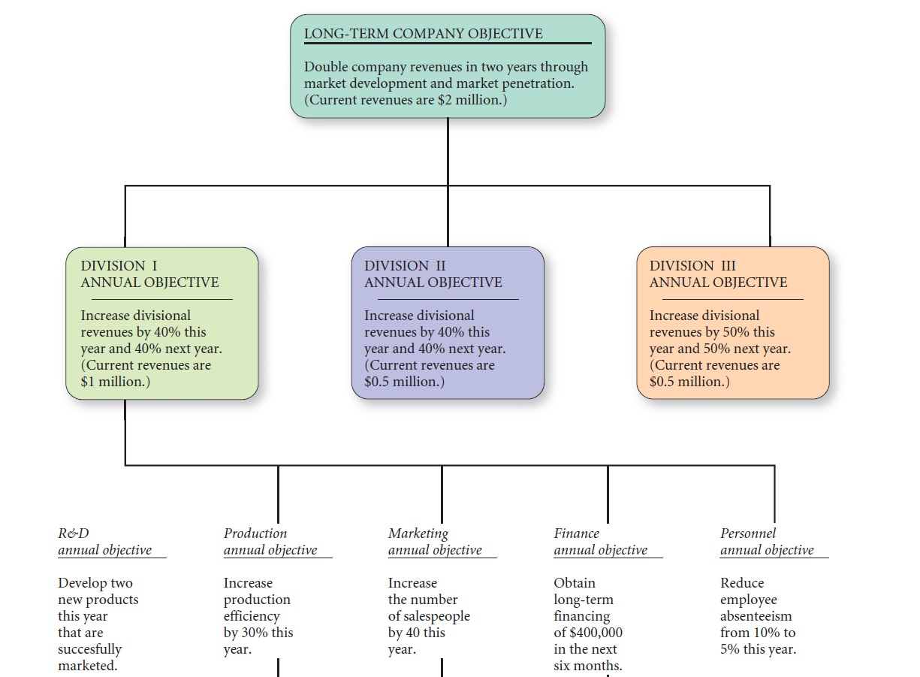
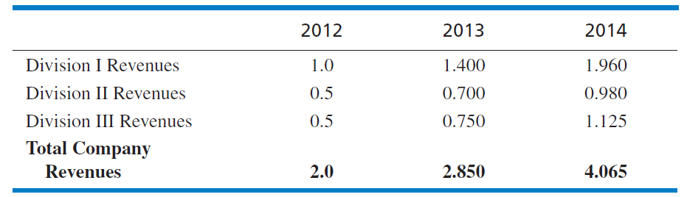
Consistency

Slide 10

Annual Objectives
maximize,
minimize,
as soon as possible,
adequate
“to improve communication”
“to improve performance”
Measurable,
Consistent,
Reasonable,
Challenging,
Clear.

Slide 11


Policies
Carnival’s Paradise ship has a no smoking policy anywhere, anytime aboard ship
Walmart has a policy that it calls the “10 Foot” Rule, whereby customers can find assistance within 10 feet of anywhere in the store.
policy refers to specific guidelines, methods,
procedures, rules, forms, and administrative practices established to support and encourage work toward stated goals.
Policies let both employees and managers know what is expected of them, thereby increasing the likelihood that strategies will be implemented successfully.

Slide 12

Resource Allocation
financial resources,
physical resources,
human resources,
Technological resources
Strategic management itself is sometimes referred to as a “resource allocation
process.”

Slide 13

Managing Conflict
Conflict is unavoidable in organizations, so it is important that conflict be managed and resolved before dysfunctional consequences affect organizational performance.
Avoidance
Defusion
Confrontation
Conflict is not always bad
“If everyone is thinking alike, then somebody isn’t thinking.”
George S. Patton
United States Army general

Slide 14
Matching Structure with Strategy
dictates how objectives and policies will be established
objectives and policies established under a geographic organizational structure are couched in geographic terms. Objectives and policies are stated largely in terms of products in an organization whose structure is based on product groups
structure dictates how resources will be allocated
If an organization’s structure is based on customer groups, then resources will be allocated in that manner. Similarly, if an organization’s structure is set up along functional business lines, then resources are allocated by functional areas.
Customer group; Geographic areas; business functions; Strategic business units

Slide 15
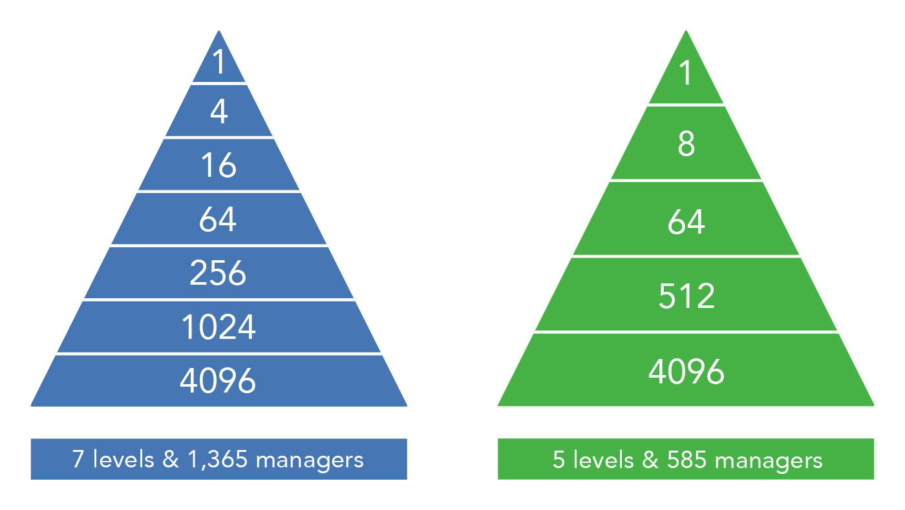
The span of control

Slide 16
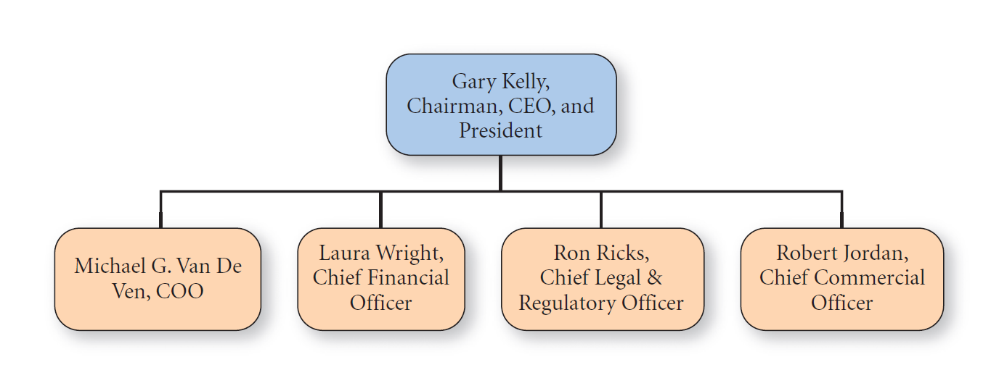
The Functional Structure
centralized type
The most widely used structure is the functional or centralized type because this structure is
the simplest and least expensive of alternatives.

Slide 17
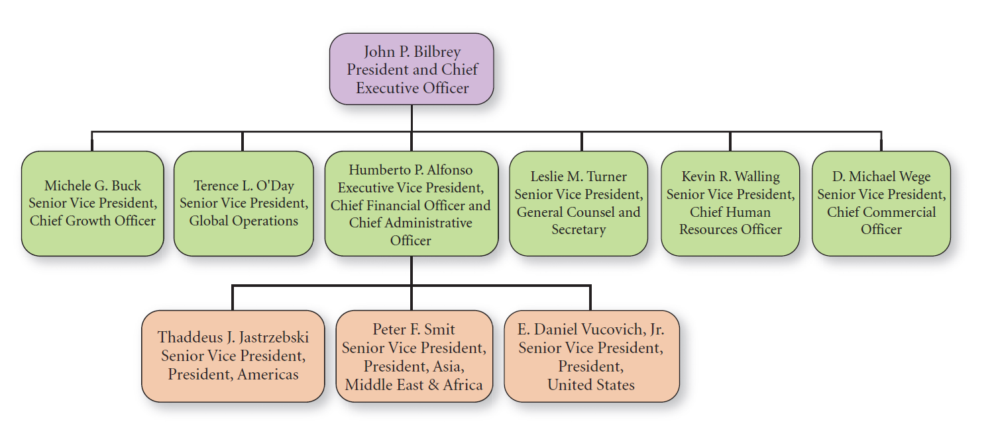
The Divisional Structure
by geographic area, by product or service, by customer, or by process.
duplication of staff
Hershey Foods’ Divisional-by-Region Organizational Chart

Slide 18
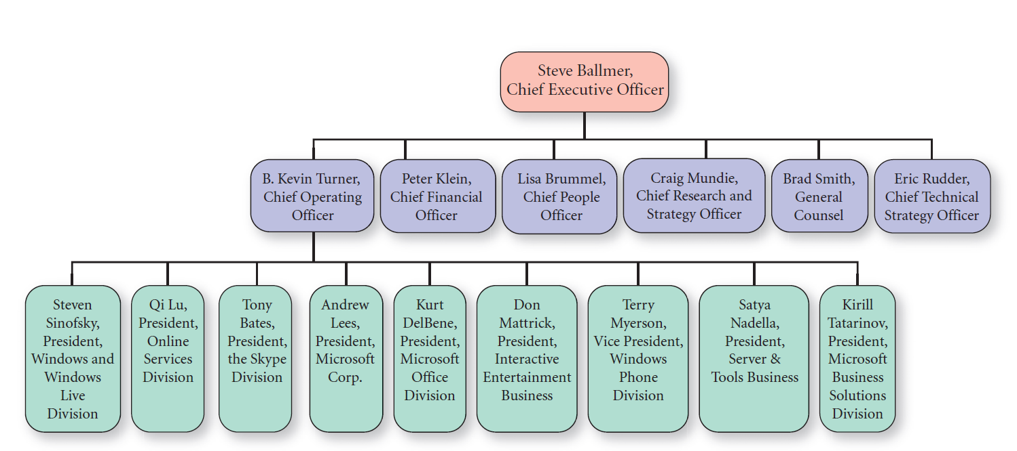
The Divisional Structure
Microsoft’s Divisional-by-Product Organizational Structure

Slide 19
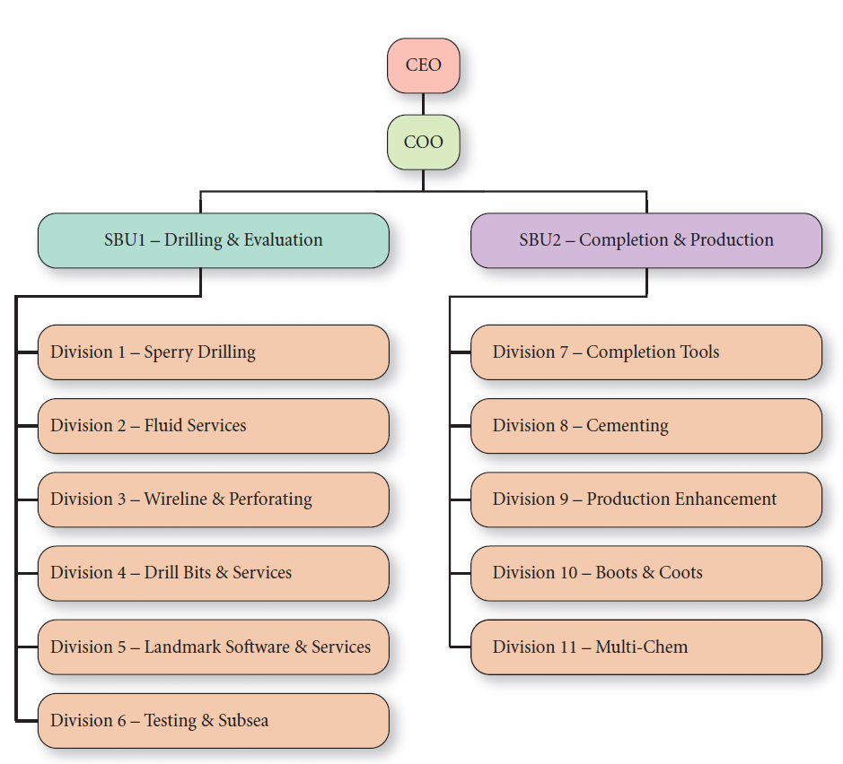
The Strategic Business Unit (SBU) Structure
An additional layer of management
Halliburton Company’s SBU Organizational Chart

Slide 20
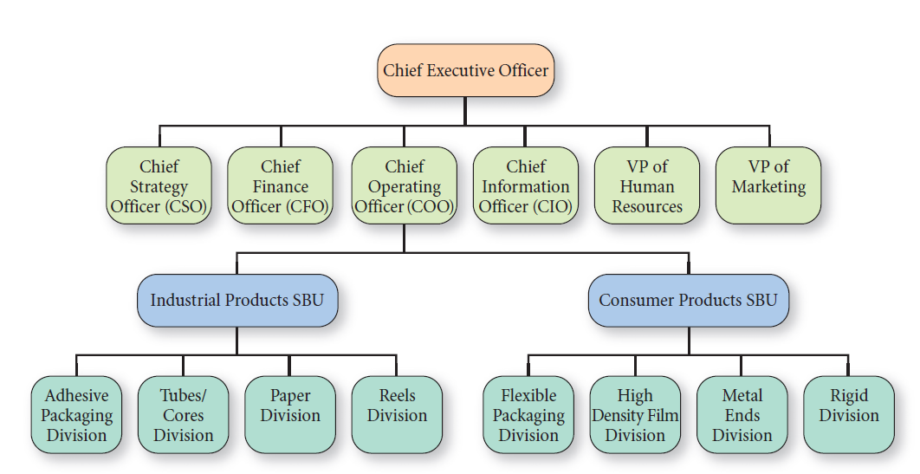
The Matrix Structure

Slide 21
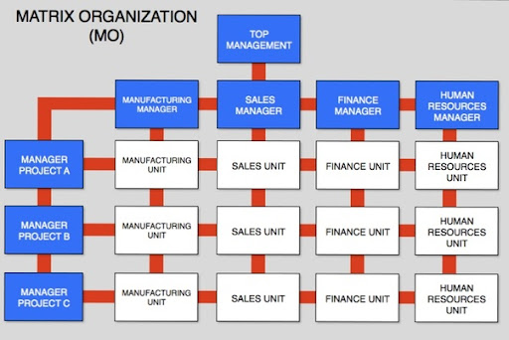

Slide 22

Human Resource Concerns When Implementing Strategies
Human resource problems that arise when businesses implement strategies can usually be traced to one of three causes:
(1) disruption of social and political structures,
(2) failure to match individuals’ aptitudes with implementation tasks
(3) inadequate top management support for implementation activities

Slide 23

Employee Stock Ownership Plans (ESOPs)
ESOPs empower employees to work as owners;
ESOPs allow firms other benefits, such as substantial tax savings;
“The ownership culture really makes a difference, when management is a facilitator, not a dictator,”
Human Resource Concerns

Slide 24
Balancing Work Life and Home Life
Glass ceiling
median salary for female physicians is $112,128 versus $186,916 for men.
Globally, it is widely acknowledged that the best countries for working women are Norway, Sweden, Finland, and Denmark—that often rate above the USA.
New corporate titles such as work and life coordinator and director of diversity are becoming common.
Flexible working hours
Family days
Paternity leave
Human Resource Concerns
Good home life contributes immensely to a good work life

Slide 25


Slide 26

Benefits of a Diverse Workforce
An organization can perhaps be most effective when its workforce mirrors the diversity of its customers. For global companies, this goal can be optimistic, but it is a worthwhile goal.
Human Resource Concerns

Slide 27

Corporate Wellness Programs
Wellness incentives
lower health insurance premiums to nonsmokers
onsite exercise or yoga classes
Human Resource Concerns
Michael Porter, coauthor of Redefining Health Care, says, “We have this notion that you can gorge on hot dogs, be in a pie-eating contest, and drink every day, and society will take care of you.

Slide 28
Developing an Organizational Chart for a Georgian company (insurance/ banking/ retail chain)
Homework is the same
Homework should be prepared in a mini presentation format max 10 slides. Homework should be sent to my Mail till our next meeting

